Slide 1
CI and CD with Jenkin X and EKS on AWS

Slide 2
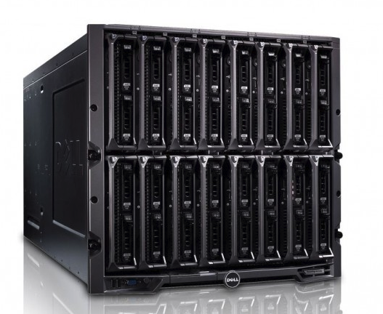
The problems
Releasing and running enterprise application in different environments is costly and difficult to scale/unscale on demand.
Every single change that we want to deploy to production requires several resources and allocated time ( usually the weekends ) to deal with the release.
Even for any small change we tend to redeploy the entire system increasing our risk of failure and often forcing us to take the previous system down.
If the prod environment are slightly different we could end up in investing lots of time in fixing bugs that didn’t show in other environments (UAT).
Fixing release issues and rollbacks can take time and lots of resources.
Environments usually needs expensive hardware and software to scale and run.

Slide 3
The solution
Split our big monolith applications in small containers and deploy them separately.
Benefits:
Costs: Multiple containers are much more efficient when it comes to resource utilisation than creating a virtual machine with its own OS for each application.
Portability: The isolation containers offer enables you to run your software consistently across environments.
Scalability: Since containers are lightweight by design, they can be created within seconds allowing us to scale/unscale at runtime without manual intervention.

Slide 4
The container orchestration
Containers are good but how to orchestrate them?
In order to orchestrate and scale/unscale containers there are several techologies.
We choose Kubernetes because it has high adoption and support available. ( Google, AWS, Microsoft..).
It is cloud agnostic and can run on premises.

Slide 5
Kubernetes the future of infrastructure

Slide 6
Continuous Deployment
Often Developers spend considerable time to move code between different environments.
Creating new environments and pipelines takes a lot of resources and time.
Getting feedback to the new features on a temporary environment is
Setting up and maintaining an infrastructure for continuous delivery in enterprise global application is costly and complex.
Example:
When we create a new project, we need to create the following:
The app skeleton containing all the configuratiuon needed
a git repo
Multiple pipeline
Different environments ( Dev, Sit, UAT, Etc..)
A workflow to promote the App to different environment
Nexus
And many other tools needed in the continuos deployment ( Code Analisy tools, Security tools, etc,, )

Slide 7
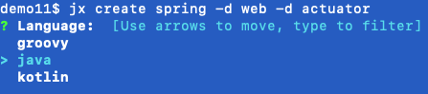
Continuous delivery with Jenkin X
Imagine the developer has a tool that can use one command line to create the project and automatically all the infrastructure needed by the project gets created in real time..
Jenkins X is a CI/CD solution for modern cloud applications on Kubernetes.

Slide 8
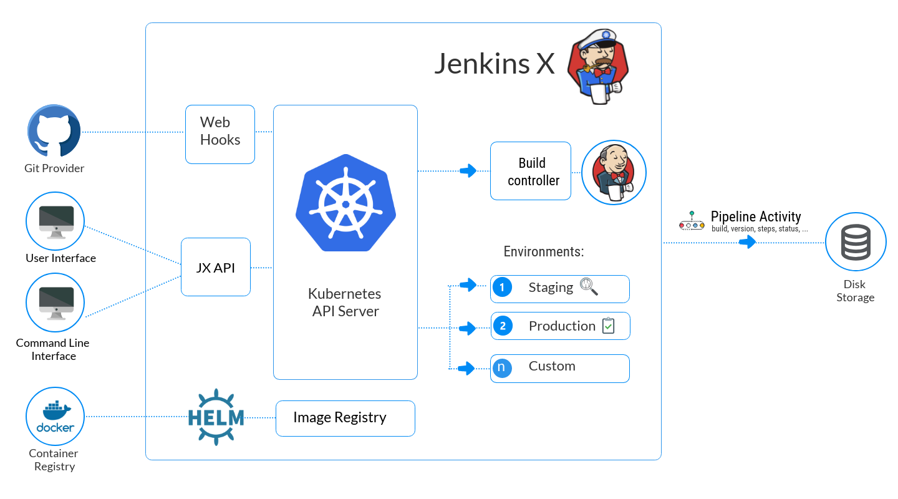
Jenkin X with Kubernetes

Slide 9
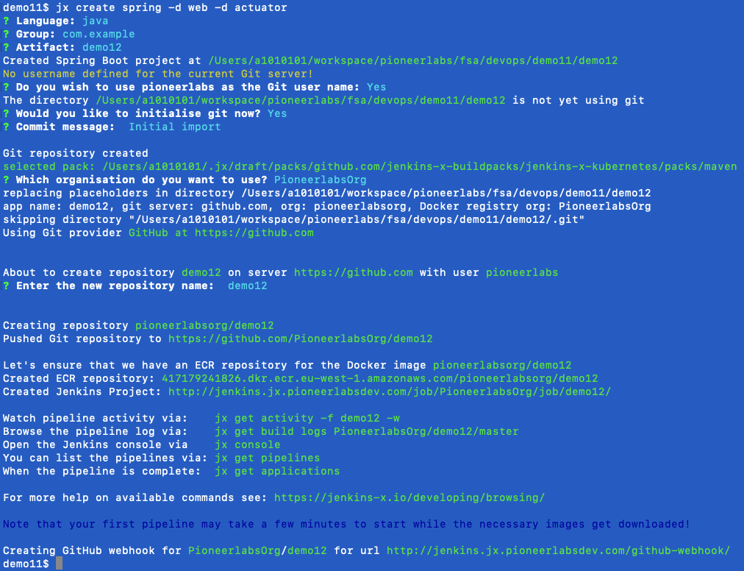
With one command we created all we what is required
Create spring project
Create git repo
Create all pipelines

Slide 10
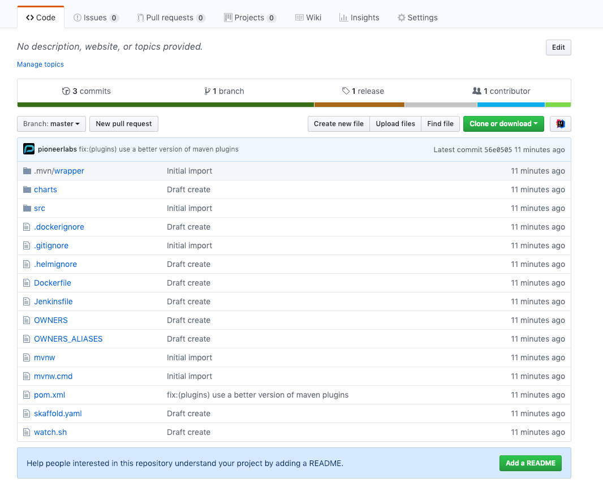
Autogenerated git repo with project skeleton
The skeleton contains all the configuration need to:
Run the app
Containerize the app
Create the pipeline for different environments
Deploy the app to Kubernetes cluster

Slide 11
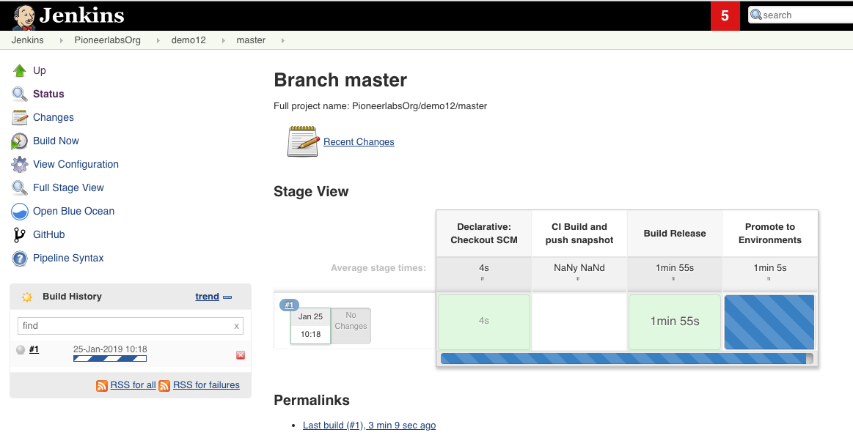
Autogenerated multi step pipeline all the way to production

Slide 12
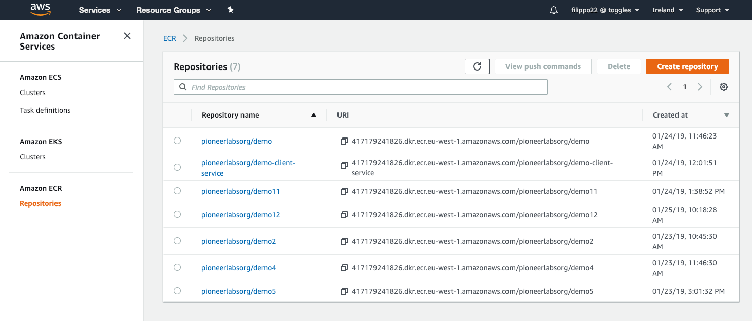
Pushing Docker container to AWS Registry

Slide 13
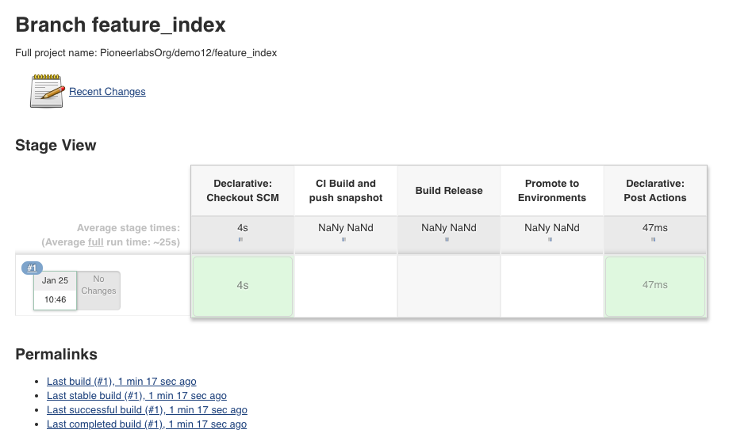
When we create short lived branches it creates temporary enviroments and pipelines

Slide 14
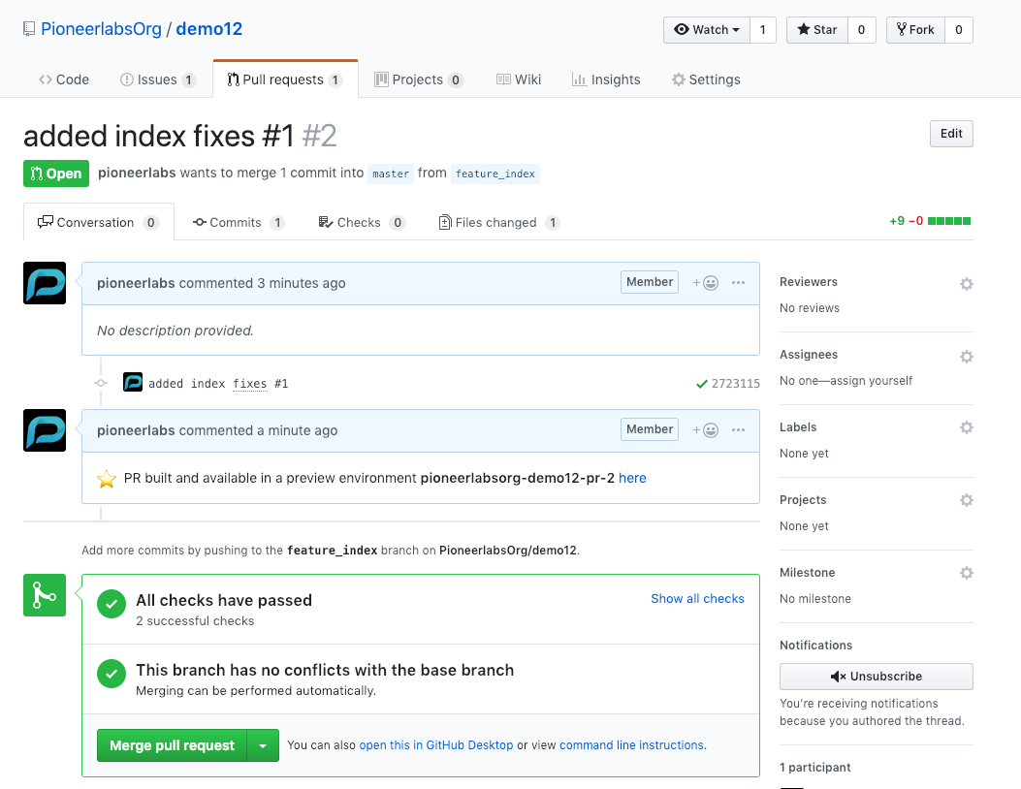
When we push the branch we can see it running in a temporary environment before approving the pull request
We can preview our changes on a temporary environment

Slide 15
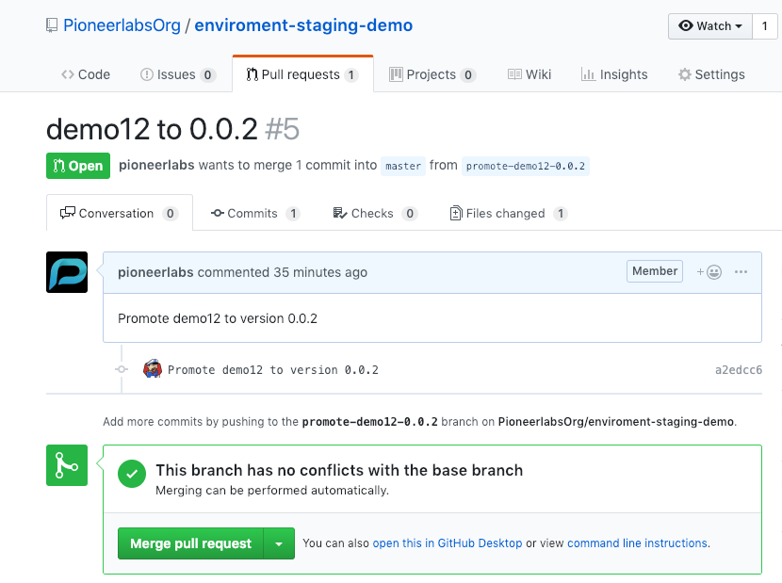
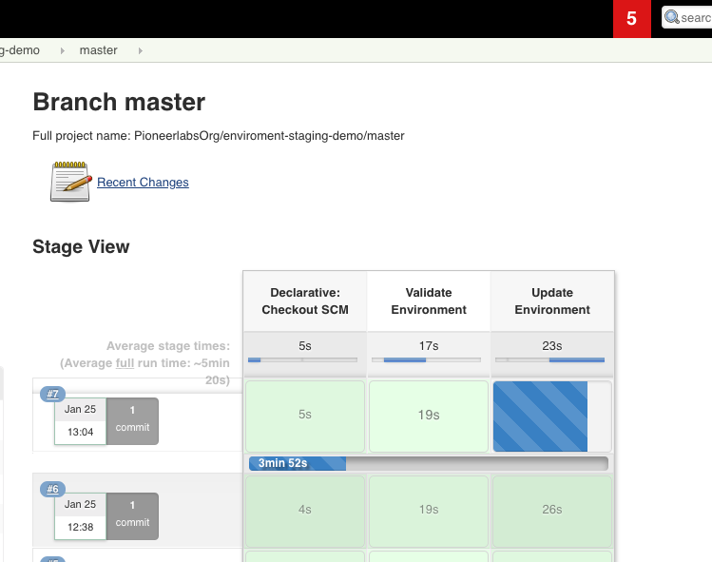
Environment uses GitOPS and pull requests to promote applications from one env to the other one

Slide 16
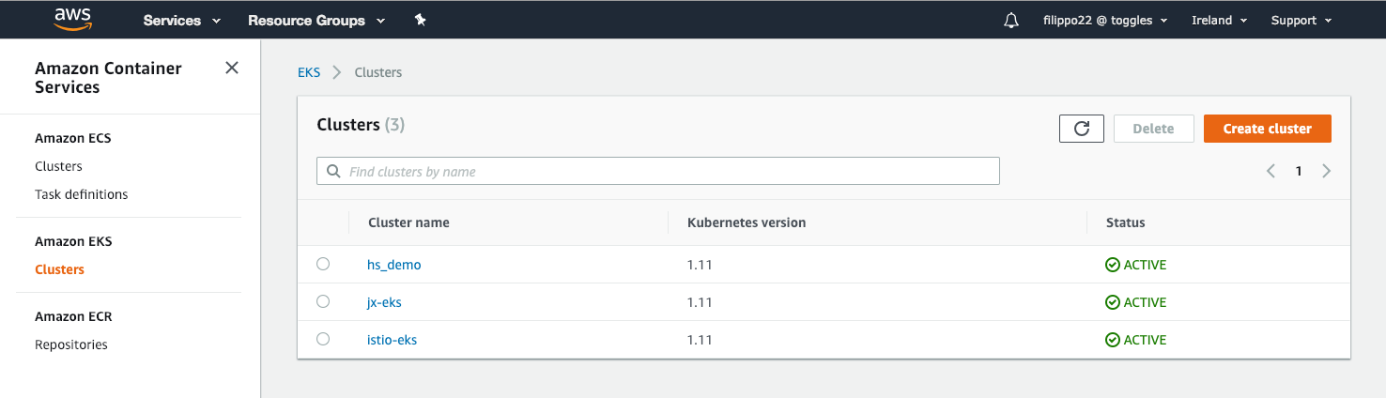
Deploying Kuberntes cluster to AWS
We deployed 3 different Kubernetes clusters using:
AWS EKS Client
AWS Console
Jenkin X client

Slide 17
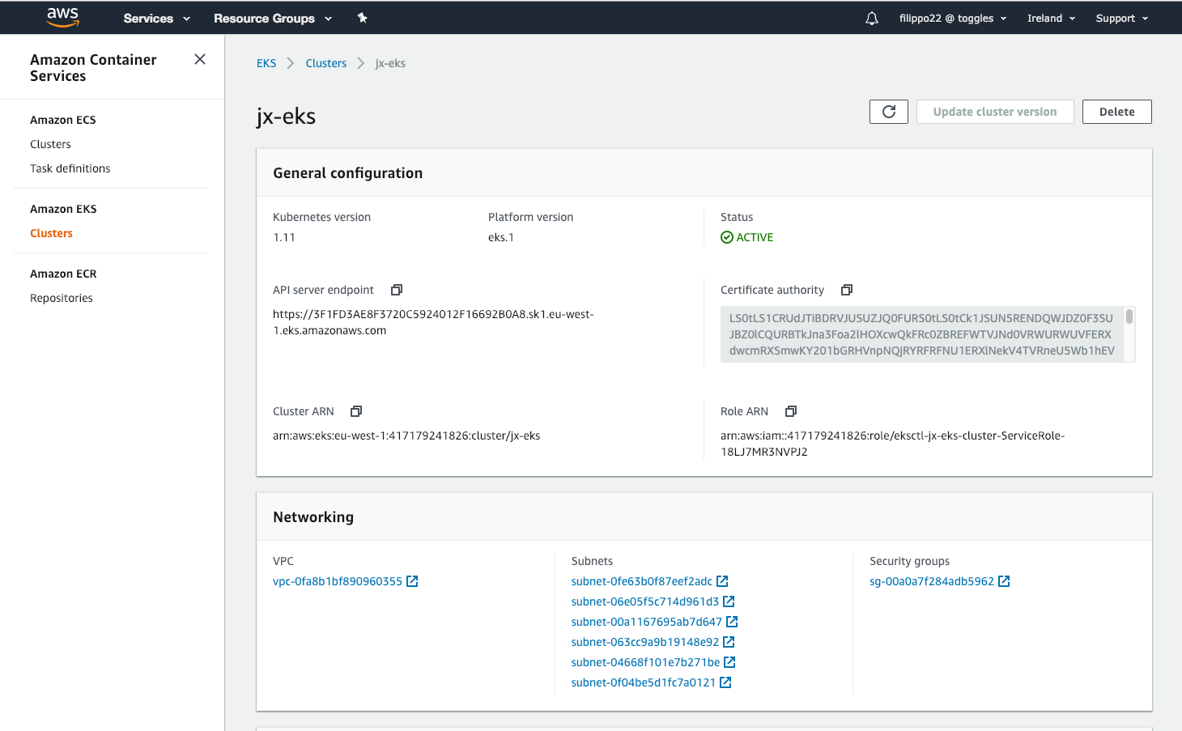
AWS EKS requirements
EKS need AWS VPCs, Subnets and security groups to be configured in order to work.

Slide 18
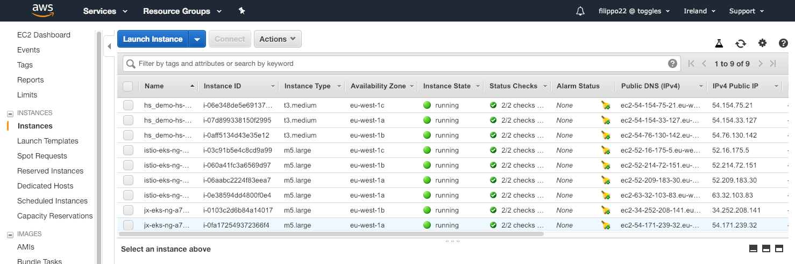
EC2 Instances created

Slide 19
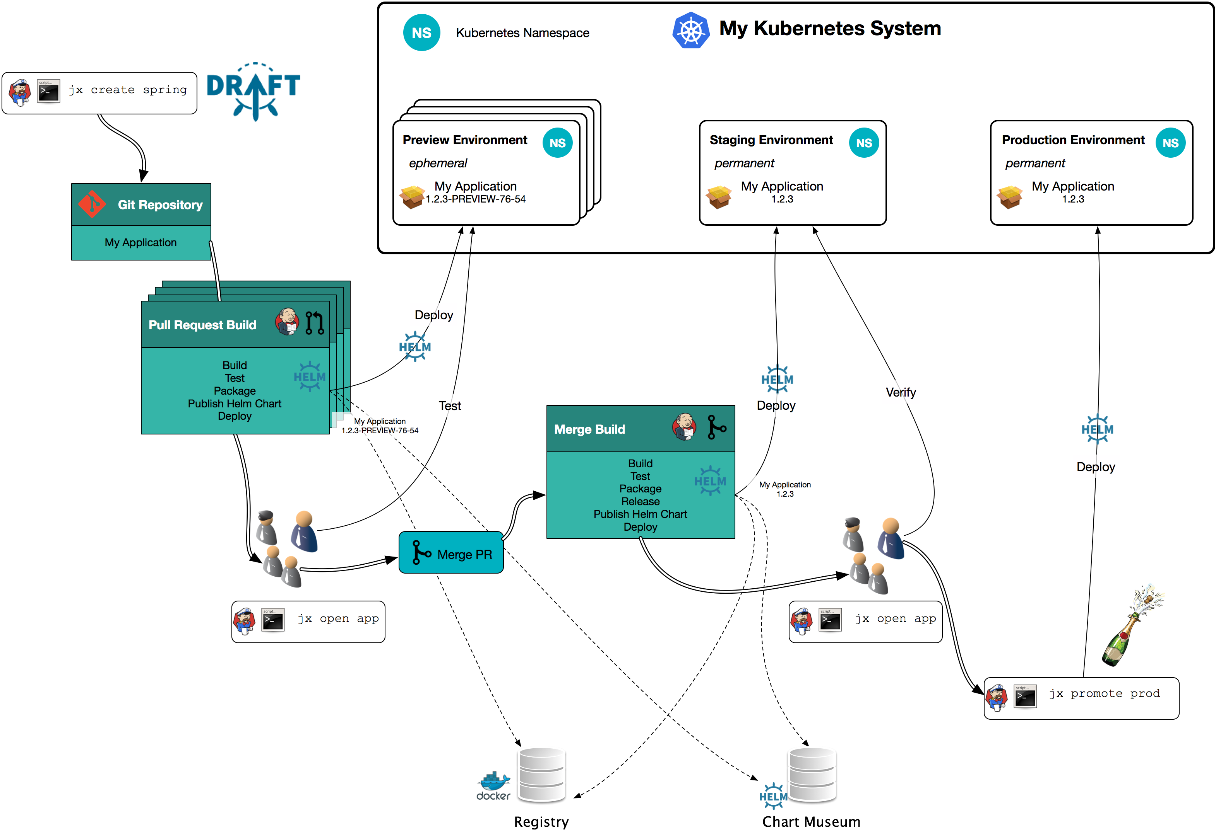
Jenkins X and Kubernetes Continuous delivery flow

Slide 20
Thank you

